Slide 1
Logistic Regression
Thang Nguyen

Slide 2
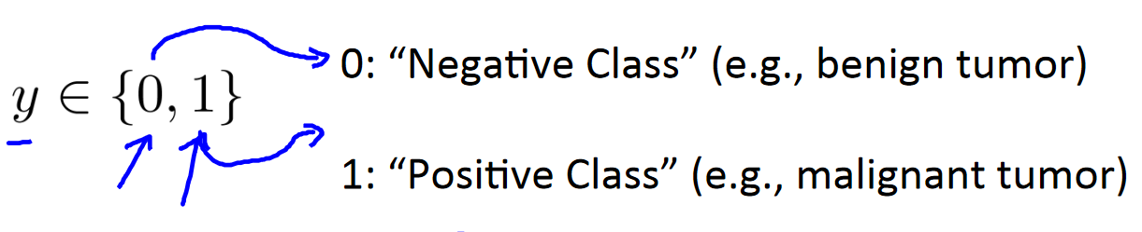
Classification
Binary Classification:
Email: Spam/ Not spam?
Tumor: Malignant / Benign?
Negative/Positive: The absence/existing of an element.

Slide 3
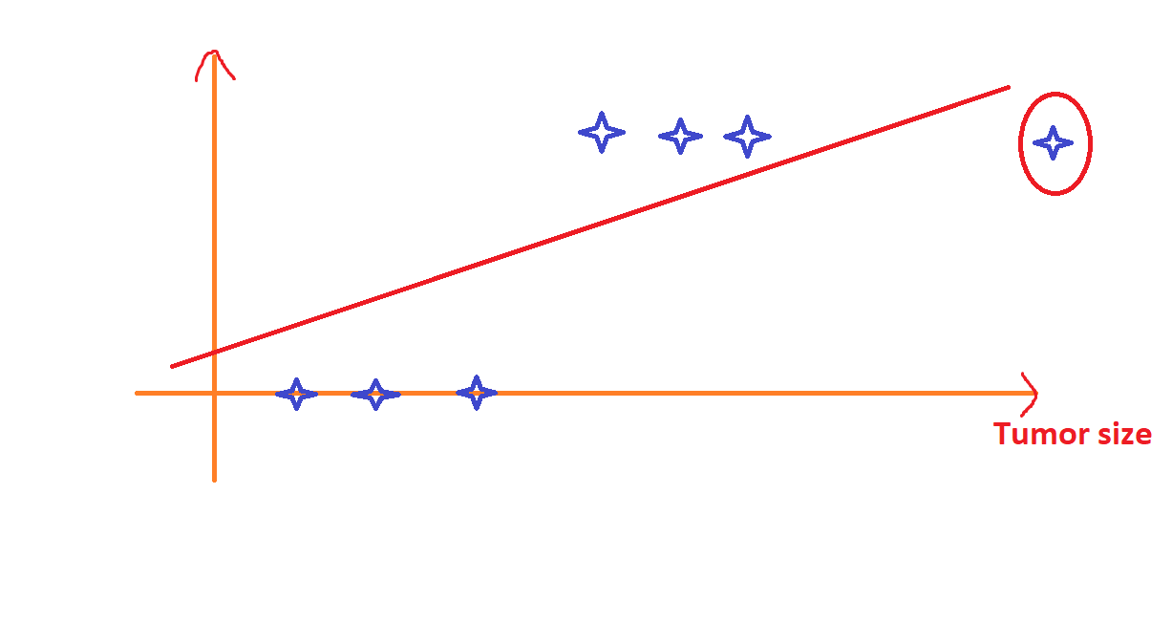
Linear regression problem
Malignant
Benign
Doesn’t fit to data

Slide 4
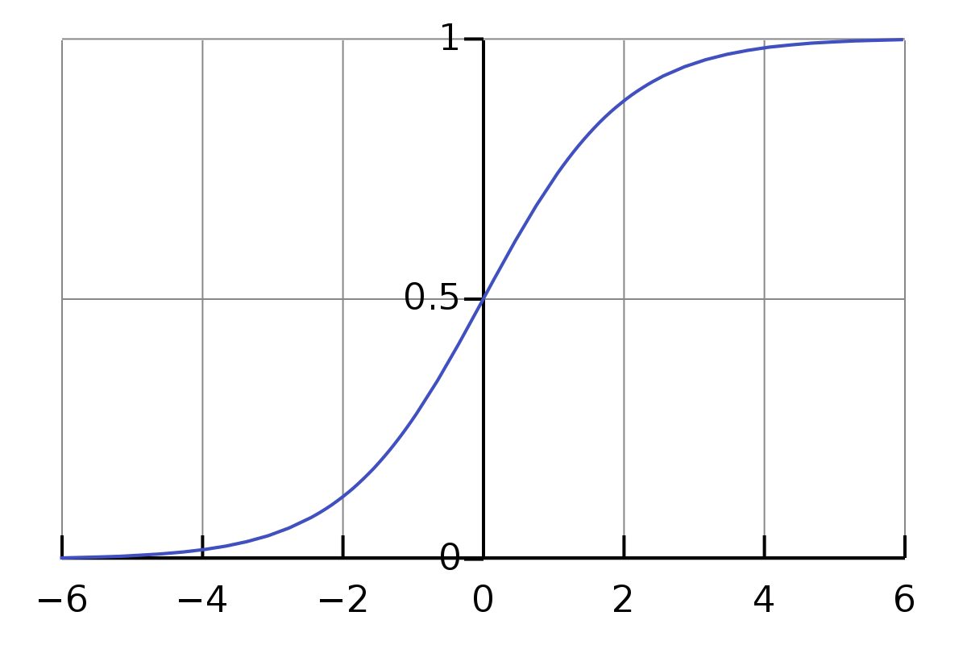
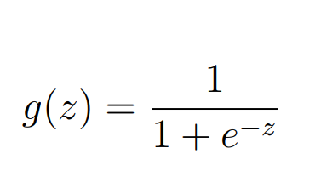
Logistic Regression
Sigmoid function:
Sigmoid function squash input into the range (0, 1)
-> Probability representation!

Slide 5
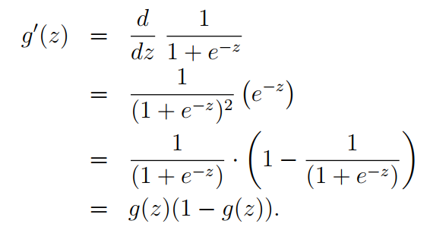
Logistic Regression
Sigmoid function:
-> Easy for implementation

Slide 6
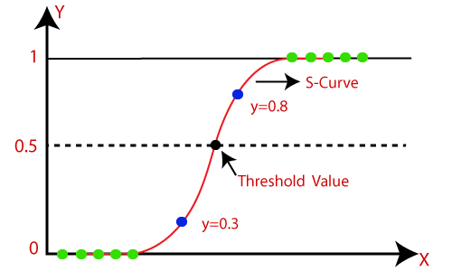
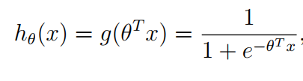
Logistic Regression
Hypothesis:

